Slide 1


dataset: IBM | Kaggle.com
Employee
Attrition
PREDICTION | HR ANALYSIS
Noelia Oriola Escobar

Slide 2




Employee Attrition
WHAT IS ATTRITION
| BUSINESS IMPACT
STAGES DATA ANALYSIS
| MACHINE LEARNING PREDICITONS
CONCLUSION
| HR STRATEGY

Slide 3

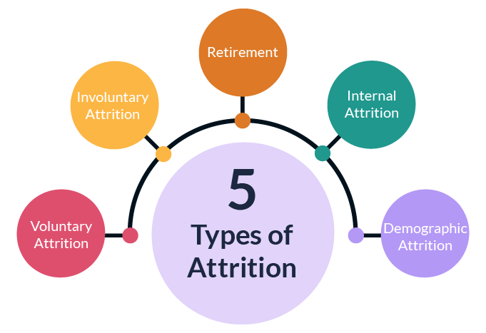
WHAT IS ATTRITION
| BUSINESS IMPACT
Employees leaving the workforce of an organization, which can occur through voluntary means like resignations and retirements, as well as involuntary actions such as terminations and layoffs.

Slide 4

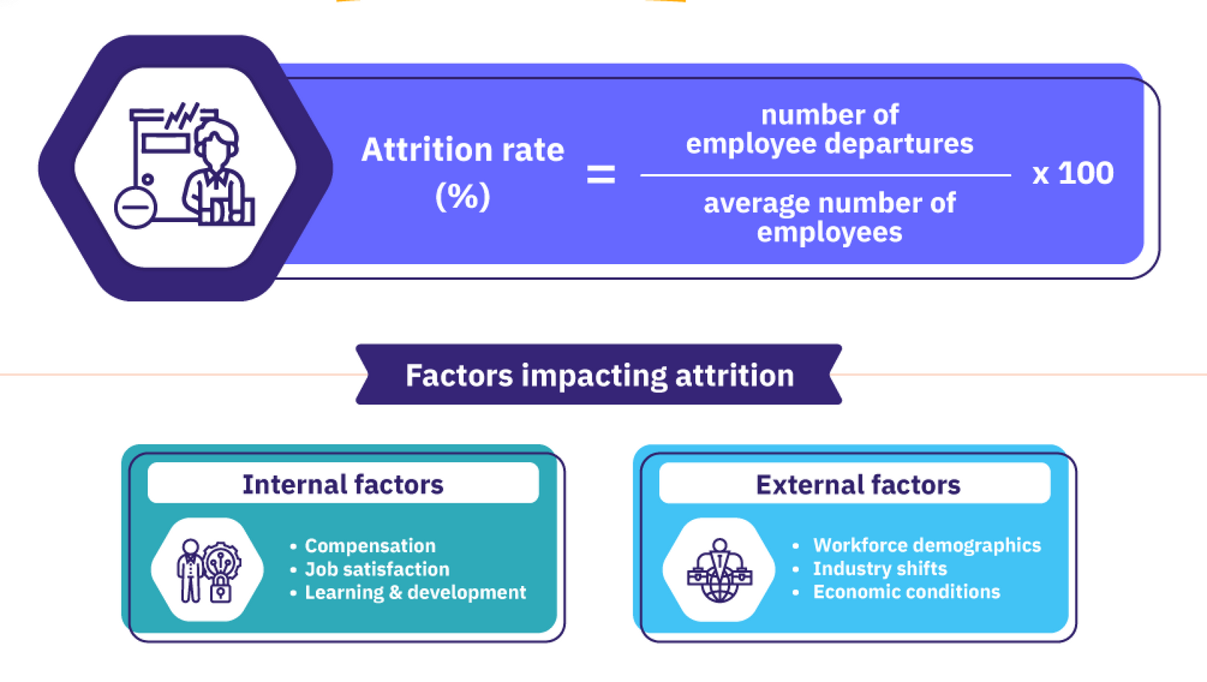
WHAT IS ATTRITION
| BUSINESS IMPACT

Slide 5

WHAT IS ATTRITION
| BUSINESS IMPACT
High attrition rates (+20%) can lead to :
Knowledge and Skills Loss (Top Performers)
Recruitment & Onboarding
Legal and Compliance Cost
Productivity Loss (missing deadlines)
Company’s Culture and Brand Image
Estimated average 10,000 - 20,000 Eur/$
cost per employee ( usually per per year)

Slide 6

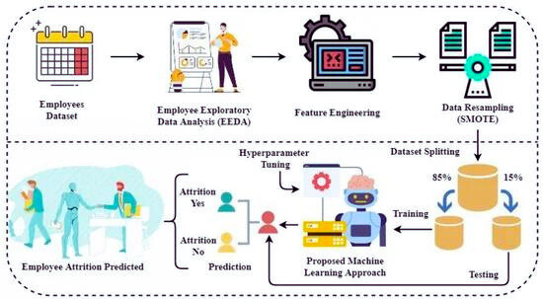
STAGES DATA ANALYSIS
| MACHINE LEARNING PREDICITONS

Slide 7
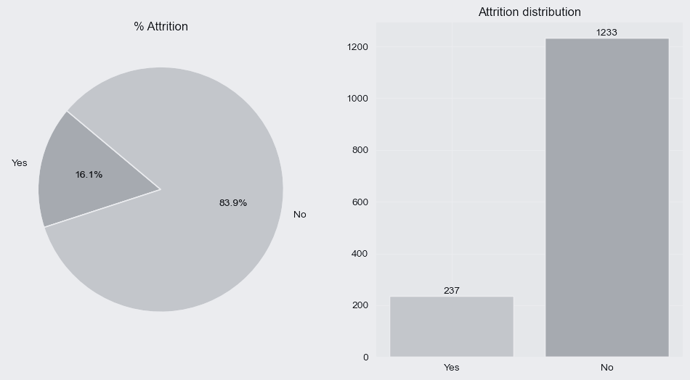

Data Analysis - EDA
Supervised Data | Class Imbalance
1470 total
16% attrition
83% active

Slide 8
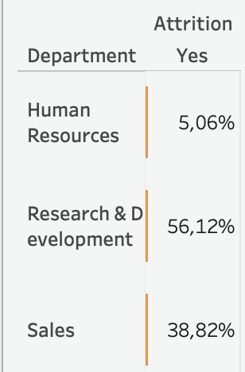

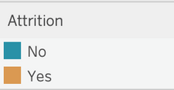
Attrition by Department
HR 63 | Sales 446 | R&D 961
HR 12 / 63 active -> 19%
R&D 133 / 961 active -> 13%
Sales 92 / 446 active -> 20%
High attrition per department

Slide 9
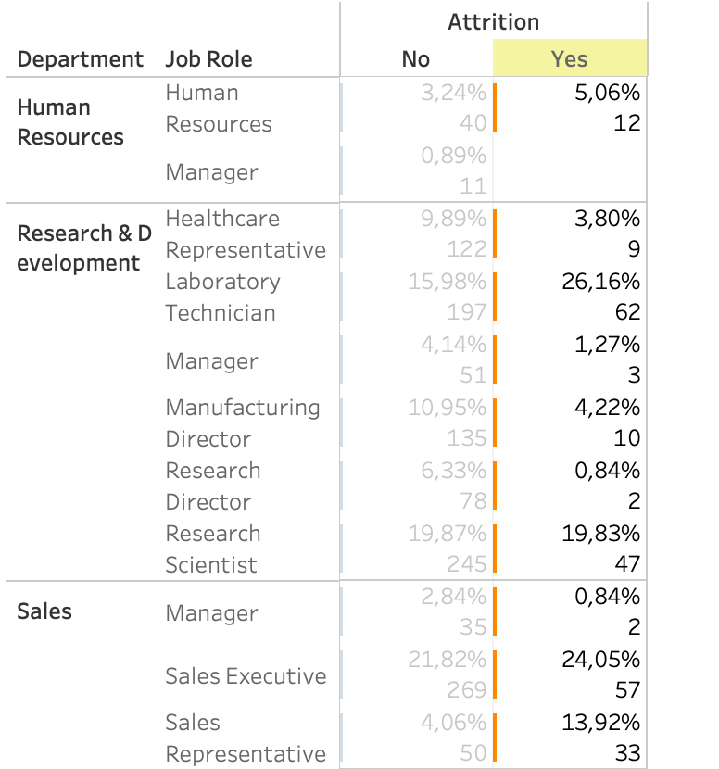
Attrition by Job Role
High attrition
job roles
Labor. Technician Research Scientist Sales Executive

Slide 10
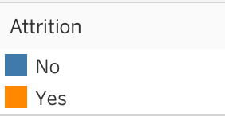
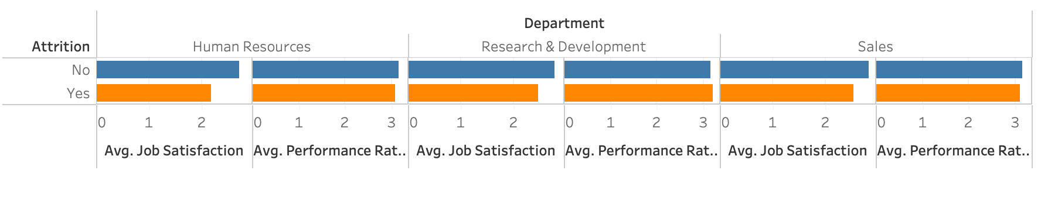
Attrition by AVG Job Satisfaction &
Performance Rating
1 ‘Low’ 2 ‘Medium’ 3 ‘High’ 4 ‘Very high’

Slide 11
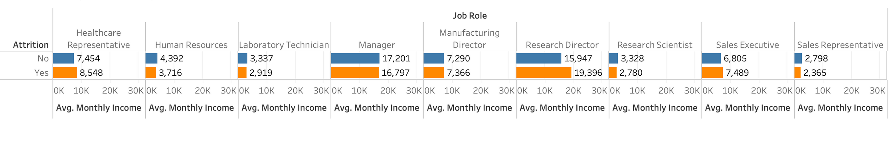
AVG Monthly Income by Job Role

Slide 12
ML Prediction Models
ML Models
Data resampling:
Random Oversampling | Unsampling | SMOTE
01
Logistic Regression
Random Forest
02
Dataset Splitting :
80 % Train | 20% Test
03
K-Nearest Neighbors
ML Model selection

Slide 13


CONCLUSION
| HR STRATEGY
KNN classifier with oversampling demonstrates promising performance metrics, showcasing robustness in classifying employee attrition with balanced precision and recall scores.
We could have identify in an early stage the 79% of our 237 attrited employees !
Kappa Score in TRAIN set: 73%
The expected accuracy of the model is 77%
KNN Classifier - TRAIN Resampled Data:
precision recall f1-score support
No 0.98 0.75 0.85 978
Yes 0.79 0.99 0.88 978
accuracy 0.87 1956
KNN Classifier - TEST Resampled Data:
precision recall f1-score support
No 0.87 0.68 0.76 255
Yes 0.14 0.33 0.19 39
accuracy 0.63 294
! Save over $1,870,000
(187 *10K cost)

Slide 14
CONCLUSION
| HR STRATEGY
01
02
Exit interview
voluntary or involuntary?
Reasons for leaving ?
date started and finished employment?
Work mode preference?
Retain employees
Personalized L&D plans
Recognition & Rewards
review salaries vs market rate
Mentorship & Leadership
Work-life balance
Inclusive work environment

Slide 15
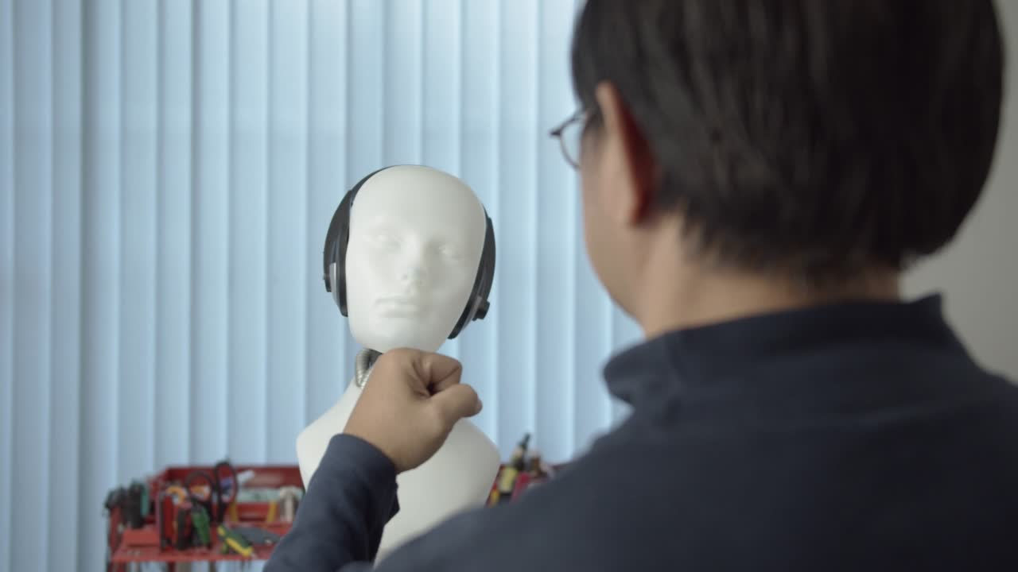
Thank You

